Slide 1


AML PORTFOLIO RISK REVIEW
AML Transaction
Monitoring Analysis
Presented by Shwetha .G
Pace is a choice.

Slide 2
PORTFOLIO ANALYSIS
8.98% of transactions triggered a suspicious-activity rule
50,000
4,489
60.9%
TRANSACTIONS
SUSPICIOUS TRANSACTIONS
HIGH-RISK RATE
$209.8M total value across 2,000 clients.
$22.2M, or 10.6% of total transaction value.
1218 High risk clients with 78.2% of transactions value..
Monitoring risk is material, but concentrated enough to support risk-based prioritization.

Slide 3
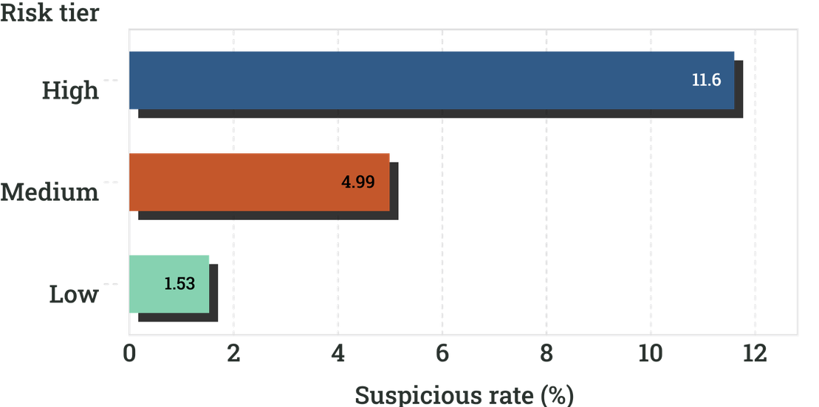
CLIENT RISK SEGMENTATION
High-risk clients carry most of the book and the highest alert rate
HIGH RISK
MEDIUM RISK
LOW RISK
1,218 clients · $159.7M value
11.60% suspicious rate
634 clients · $43.9M value
4.99% suspicious rate
148 clients · $6.2M value
1.53% suspicious rate
The step-down from High to Medium to Low suggests the composite rating is directionally aligned with observed activity.

Slide 4
STATIC RISK INDICATORS
Static risk stacks around sanctions, country exposure, and opaque ownership
Indicator | Flagged clients | Rate of client base
OFAC country | 601 | 30.05%
Sectoral sanctions | 575 | 28.75%
FATF country | 179 | 8.95%
Ownership opacity | 120 | 6.00%
PEP | 114 | 5.70%
Sanctions | 55 | 2.75%
PRIORITY LENS
Stacked flags deserve the first review pass.
Energy/Oil and Defence/Arms recur among clients with four or more static indicators.
Validate beneficial ownership and sanctions exposure before escalation.
PEP signal: $6,365 average transaction versus $4,063 for non-PEPs; suspicious rates of 10.81% versus 8.87%.

Slide 5
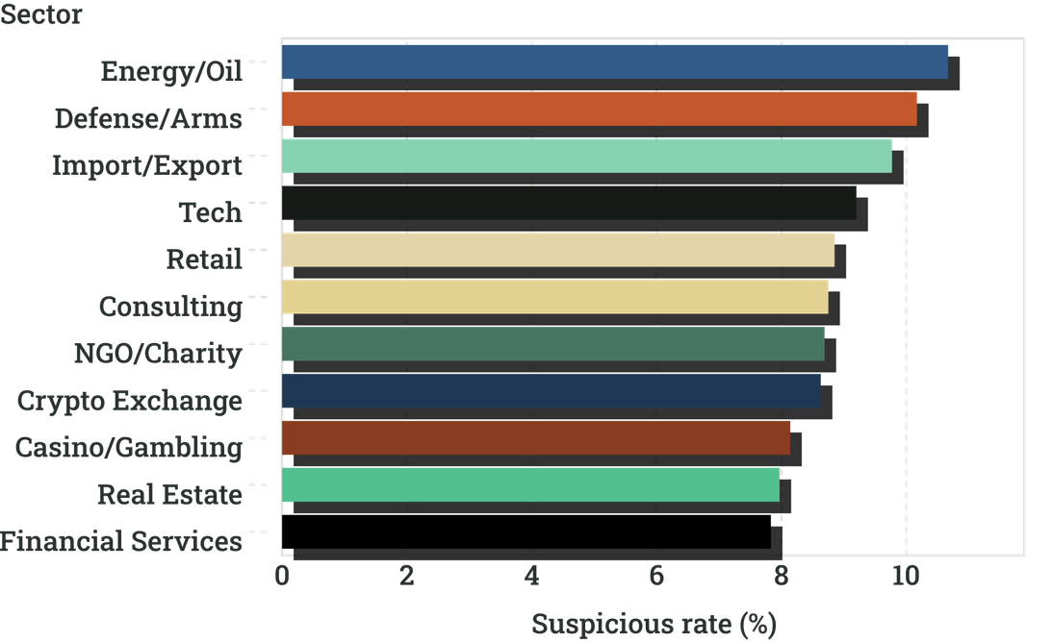
SECTOR ANALYSIS
Energy/Oil and Defence/Arms lead sector risk, while Tech is a quiet outlier
IMPORTANT HIGHLIGHT
Tech is Low risk by classification, but not quiet in observed alerts.
Rapid movement leads every sector. Energy/Oil and Defense/Arms also lead in absolute OFAC and FATF activity.
Review Tech for sanctions-driven exposure rather than screening it out by baseline label.

Slide 6
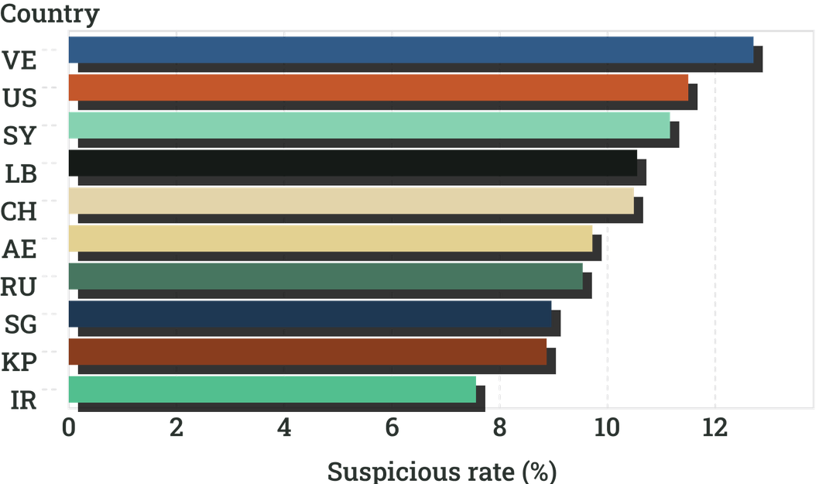
COUNTRY ANALYSIS
Country risk is concentrated in a small set of flagged populations
CONCENTRATED FLAGS
Country indicators are powerful prioritization signals—not conclusions.
All 108 Venezuela clients are OFAC-flagged. All North Korea clients are both FATF- and OFAC-flagged. All 95 Iran clients carry both flags.
Apply enhanced KYC and sanctions screening first, then validate individual list matches.

Slide 7
CROSS-COUNTRY ANALYSIS
Corridors reveal sharper concentration than country averages
Client country | Counterparty country | Transactions | Total value | Suspicious rate (%)
SY | RU | 36 | $117,597.10 | 100%
VE | IR | 34 | $196,536.79 | 100%
VE | RU | 34 | $116,108.41 | 100%
SY | SY | 32 | $127,055.64 | 100%
VE | SY | 31 | $100,343.96 | 100%
VE | VE | 27 | $195,768.00 | 100%
PORTFOLIO CONTEXT
10.00%
Domestic suspicious rate across 2,419 records.
8.93%
Cross-border suspicious rate across 47,581 records.
Validate whether country-risk flags are driving the 100% corridor rates before escalating as confirmed illicit activity.

Slide 8
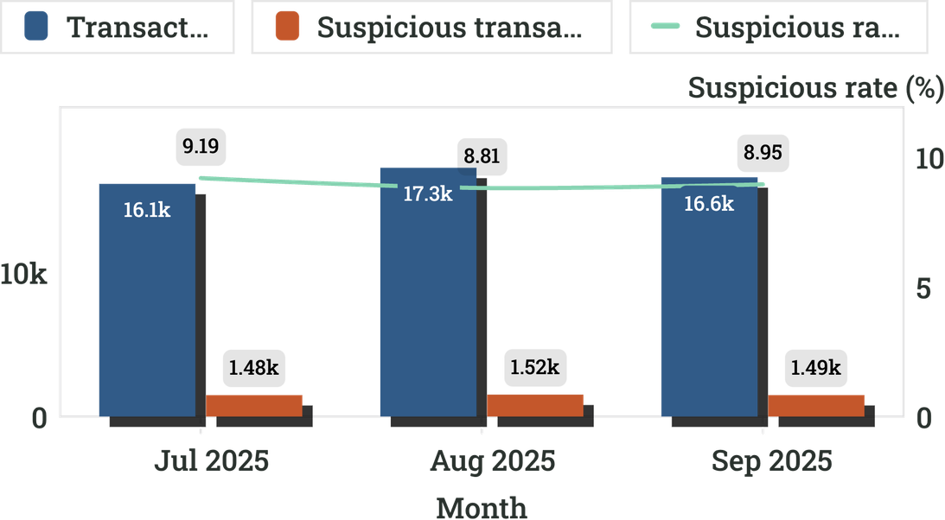
TREND ANALYSIS · JUL–SEP 2025
Suspicious rates eased modestly as volume stayed elevated
JULY
AUGUST
SEPTEMBER
16,141 -transactions · 1,483 -suspicious 9.19% - rate
17,260 -transactions 1,520-suspicious 8.81%-rate
16,599 -transactions · 1,486-suspicious · 8.95%-rate
Absolute suspicious counts remain high. The data alone cannot determine whether the rate dip reflects improved monitoring or a changing activity mix.

Slide 9
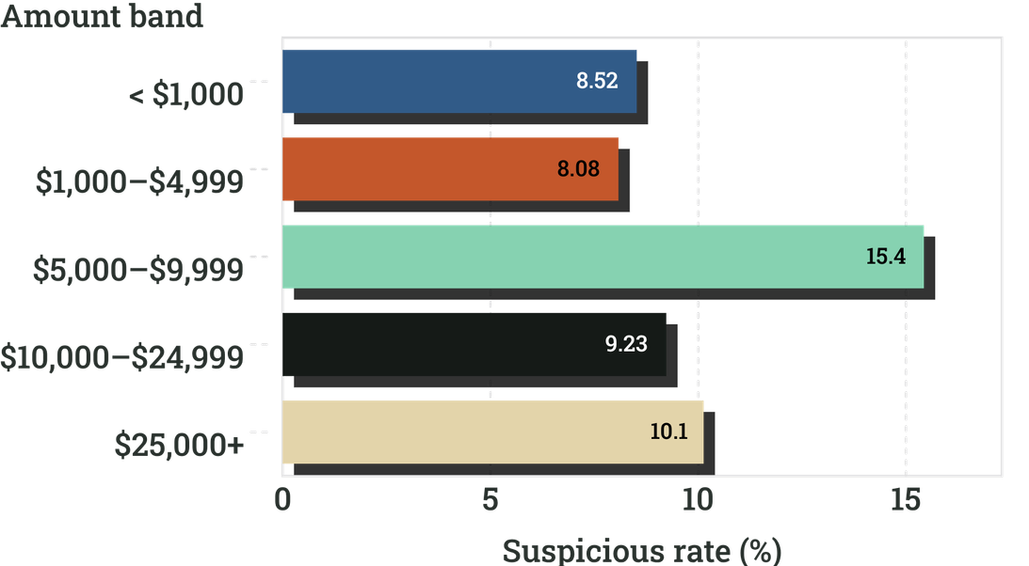
TRANSACTION PATTERN ANALYSIS
The strongest behavioural signal sits in the $5K–$9.9K band
Highest rate: $5K–$9.9K
15.43% suspicious across 4,304 transactions.
Highest volume: $1K–$4.9K with 24,268 transactions and 1,961 suspicious transactions.
Three transactions clustered just below $10,000 should trigger review—not be treated as proof of structuring.
Outlier: z-score 6.18; $154.9K transaction versus a $7.1K client average.

Slide 10
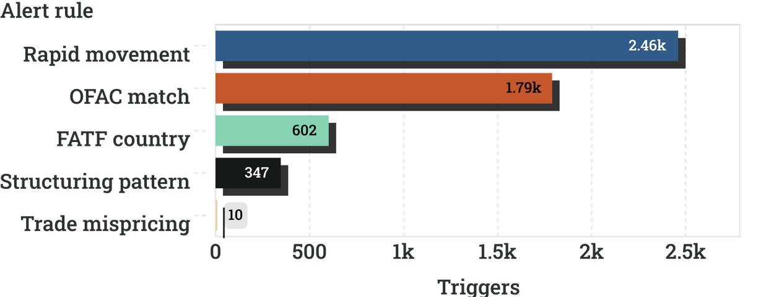
ALERT DRIVERS · INVESTIGATION PRIORITIES
Monitoring workload is concentrated in two rules, with complementary coverage underneath
Prioritize dominant queues; retain smaller rules for coverage.
  Triage: Review rapid movement and OFAC alongside stacked country and ownership flags.
  Validate: Check list matches, beneficial ownership, and corridor context before escalation.
  Preserve coverage: Keep structuring and trade-mispricing active as complementary signals.
Triggered rates: Rapid movement 4.92% · OFAC match 3.58% · FATF country 1.20% · Structuring 0.69% · Trade mispricing 0.02%
Co-occurrence: 11 of 347 structuring alerts also fire rapid movement (3.2% overlap). Treat alerts as investigation leads, not proof of illicit activity.

